Slide 1
FINANCIAL ANALYSIS ON OFFICE SUPPLY 2013 & 2014
Analyst: Ayomide Balogun
Analyst: Olamide Adesina

Slide 2
EXECUTIVE SUMMARY
Gross Sales for the period under review 127.93m
Profit Margin is 261.55k
Total Tax is 727.79k
Total Revenue is 121.32m
Profit After Tax is 13.83m
Discount is 6.71m
Profit before Tax 14.56m

Slide 3




Calculated Indices
-261.55K%
Profit Margin

Slide 4
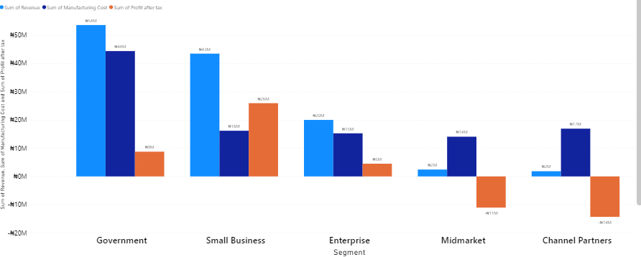
Revenue, PAT, Gross Sales by Segment Overview

Slide 5
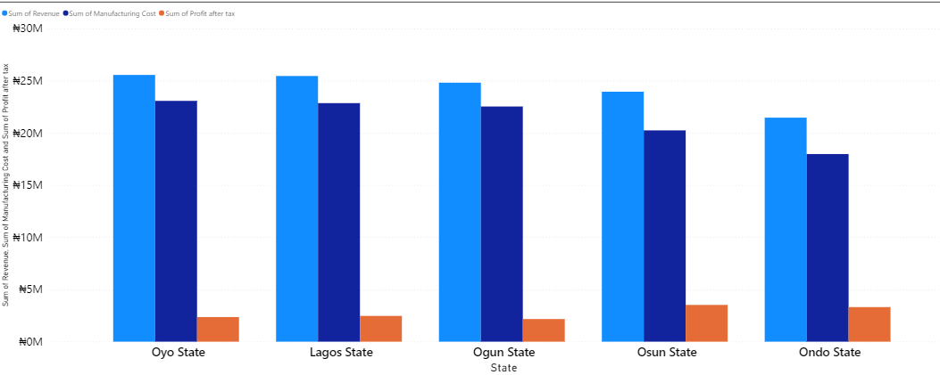
Revenue, Gross Sales and Tax by State Overview
Oyo State is our highest selling point. However, we make higher profit after Tax in Lagos.
Oyo, Lagos and Ogun state made more sales and revenue.

Slide 6
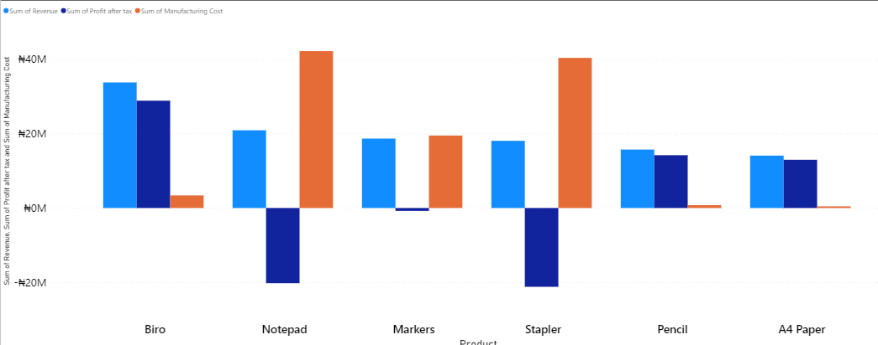
Revenue, Gross Sales and Tax by Product Overview
Biro has the highest sales point.
Staplers and notepad are running at a loss due the manufacturing cost.
Sales of Production and Revenue of Pencils and A4 paper are doing well so far.

Slide 7
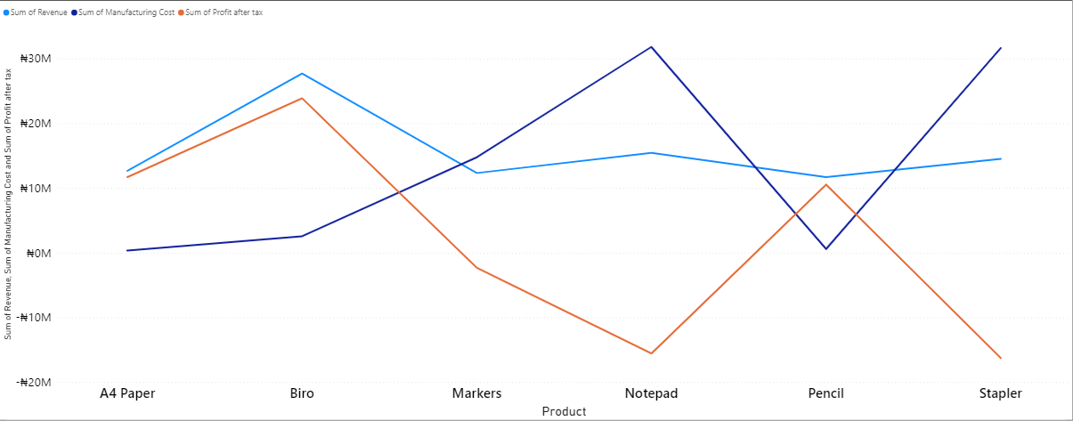
Monthly Financial Performance (2014)

Slide 8
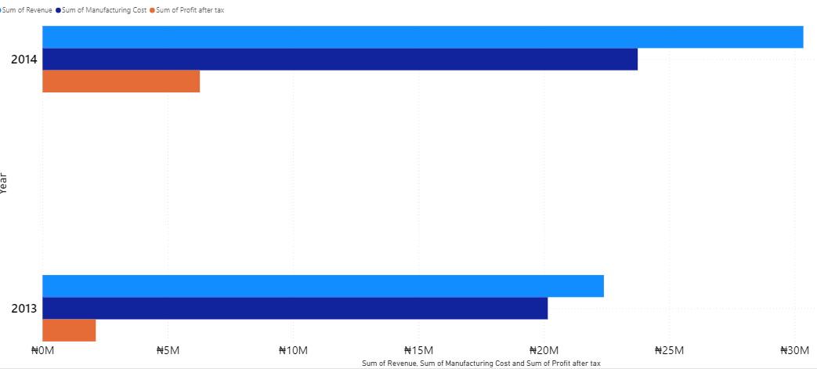
Units Sold by Year and Profit
Year 2014 has been a better year for us in terms of Revenue.
We made more profit, spent less manufacturing cost and more Profit after Tax.

Slide 9
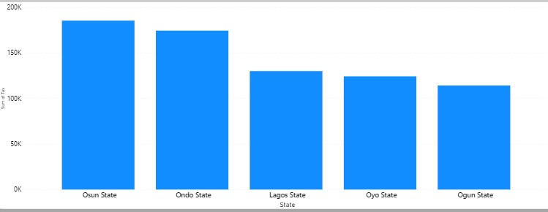
Sum Of Tax by State
The taxation from Ogun, Oyo and Lagos are favorable to the business.
However, We pay the highest tax in Osun State followed closely by Ondo State even if we make least sales there.

Slide 10
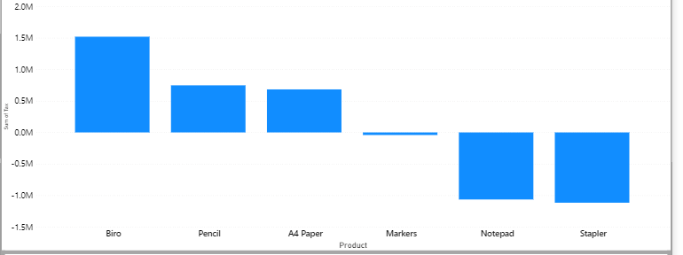
Sum Of Tax by Product
Biro is the most taxed Product here followed closely by Pencil.
Marker, Notepad and Pencil taxes are running at a loss.

Slide 11
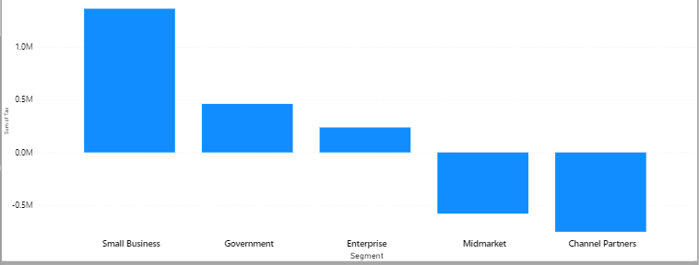
Sum Of Tax by Segment
Small Business pays the highest amount of tax and Enterprise Segment pays the least.

Slide 12
Key Findings
Office Supply generated a negative profit margin.
Biro, A4paper and Pencil are key business drivers.
Biro had the highest sales point in Q4 2013 and 2014
.Government and Small business segment makes more revenue for the business.
Small business pays the highest tax.
Lagos State has the highest sales for 2014 in Q4 2014 against Q4 2013.
For year 2014, there were more sales and revenue in month September.
Oyo state is our highest revenue point in business. Oyo, Lagos and Ogun State makes more sales compared to Osun and Ondo.
Products are heavily taxed in Osun and Ondo compared to other states.

Slide 13
Recommendations
Management should examine the manufacturing cost of Notepad, Staplers and Markers as the business is running at a loss with the sales.
Management should invest more on sales of Pencil as it requires low manufacturing cost but a higher Profit after tax.
The taxing of products in Osun and Ondo state should be checked because products are highly taxed there.
Management should consider financing production of more A4paper and Pencils.
Due to loss in Stapler and Notepad, we should discontinue these products until reduced cost in manufacturing

Slide 14
THANK YOU

